Slide 1
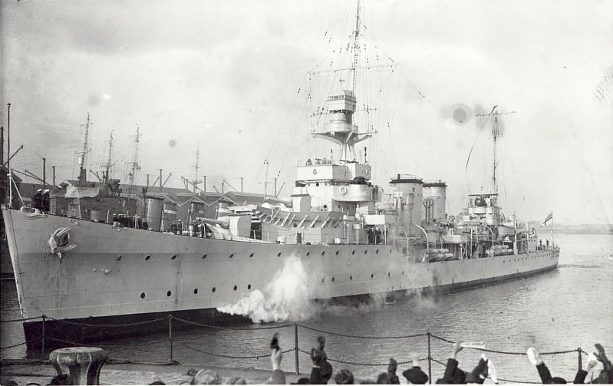

Slide 2
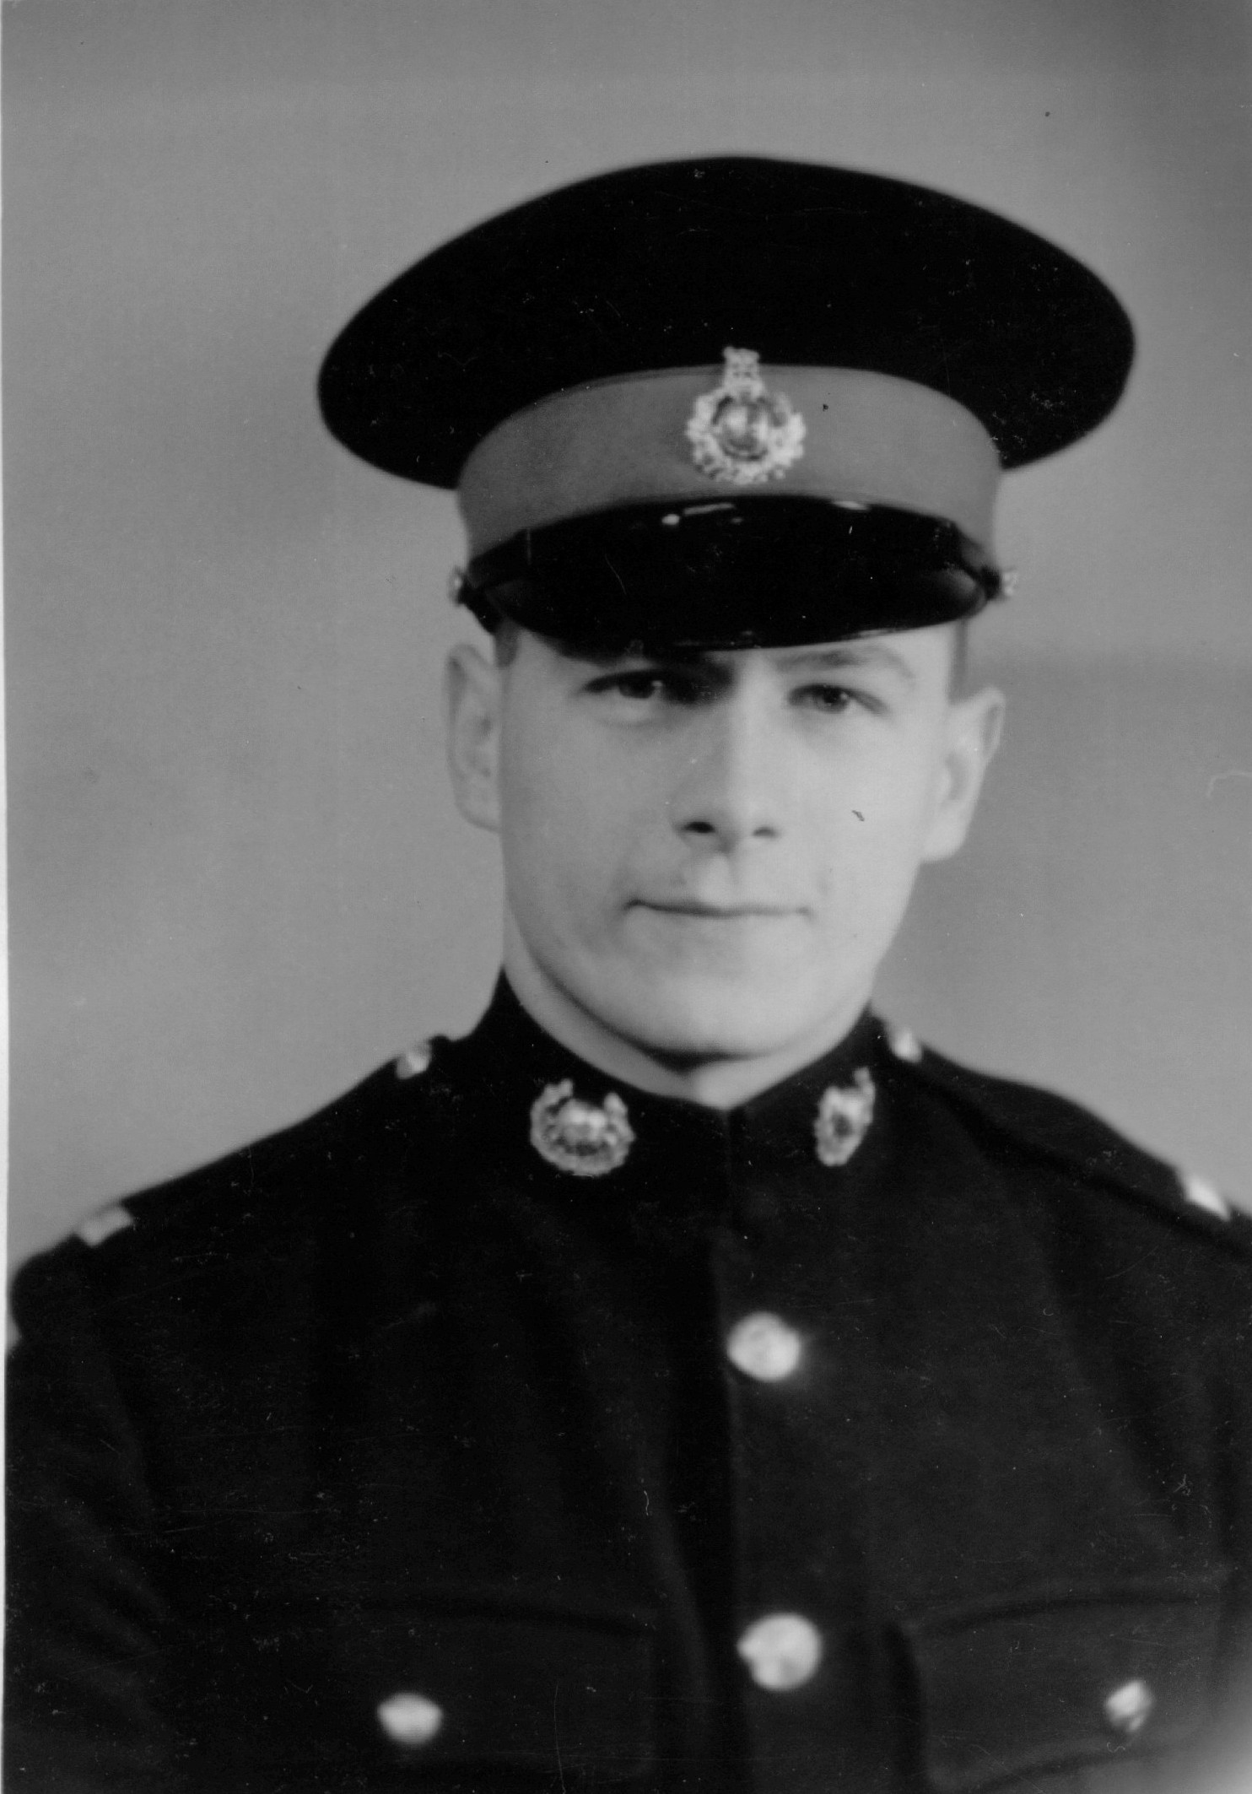

Slide 3
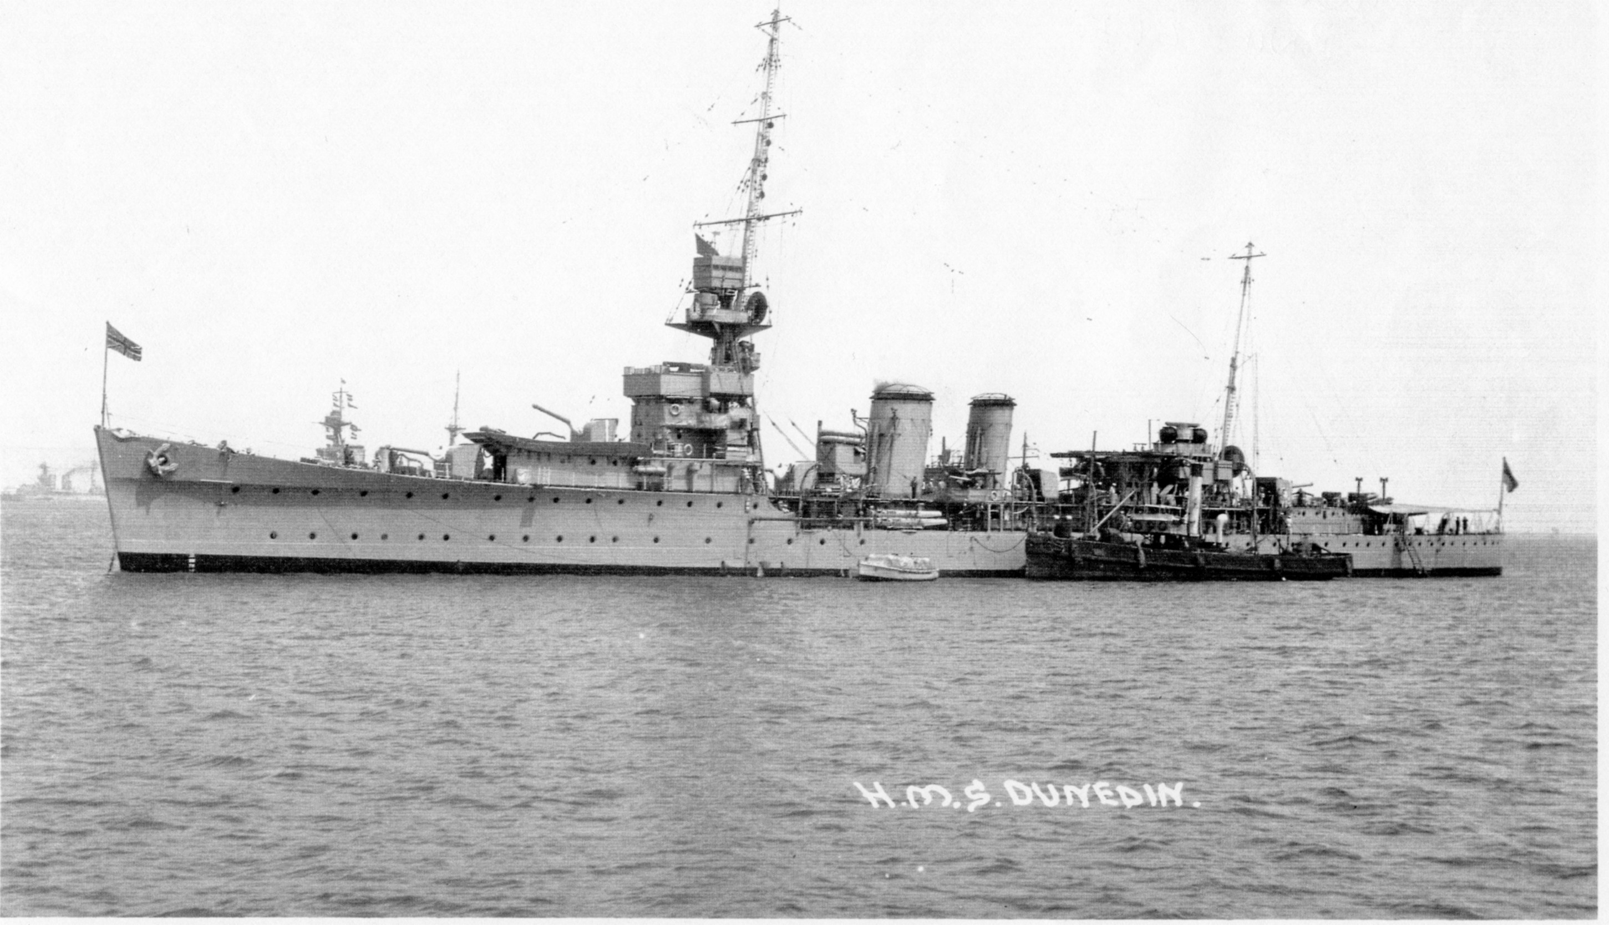

Slide 4
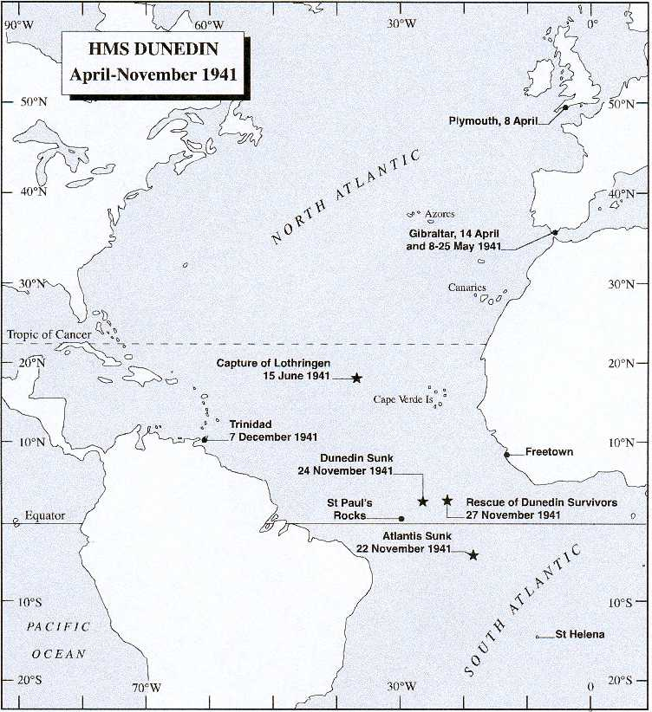

Slide 5
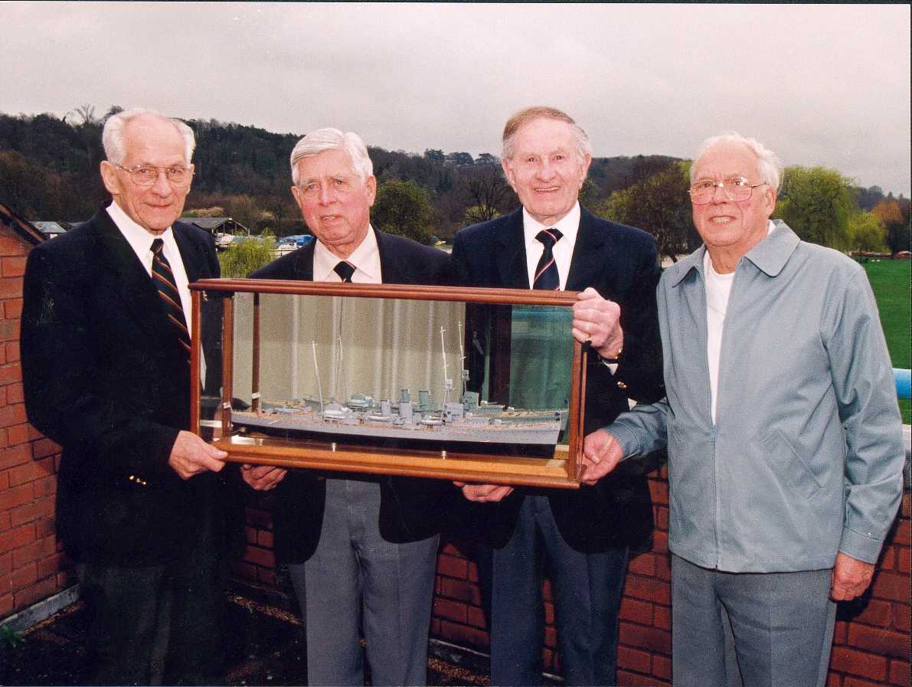

Slide 6
Notes:
November 2006

Slide 7
Notes:
National Arboretum 2006

Slide 8
www.hmsdunedin.co.uk

Slide 9
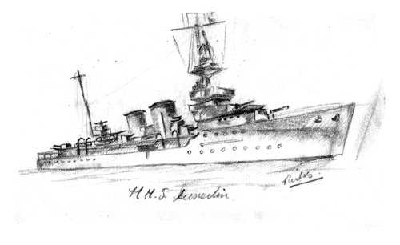

Slide 10
Specifications
Displacement 4,850 tons
Length 472 ft 3in
Beam 46ft 3in
Speed 29 knots
Range 6,700 nautical miles at 10 knots
Armaments 6 x 6-in guns, 3 x 4-in guns, 12 x 21-in torpedoes
Compliment 450 (480 at time of sinking)

Slide 11
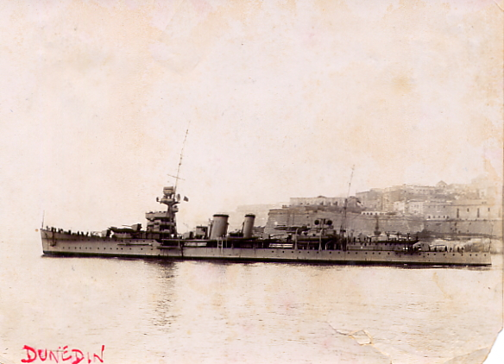
Notes:
Malta

Slide 12
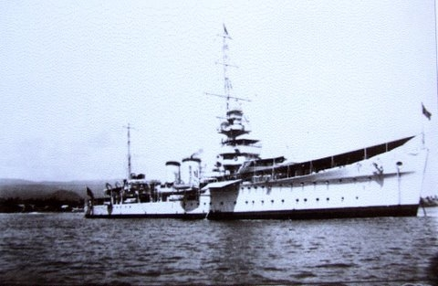

Slide 13
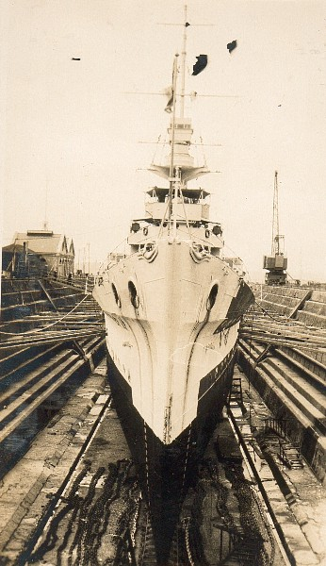
Notes:
Sept 1928 – probably Auckland

Slide 14
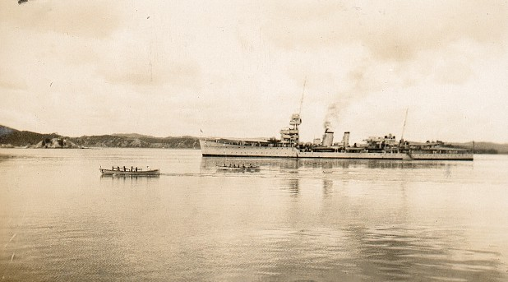
Notes:
5th February 1929 – probably Auckland

Slide 15
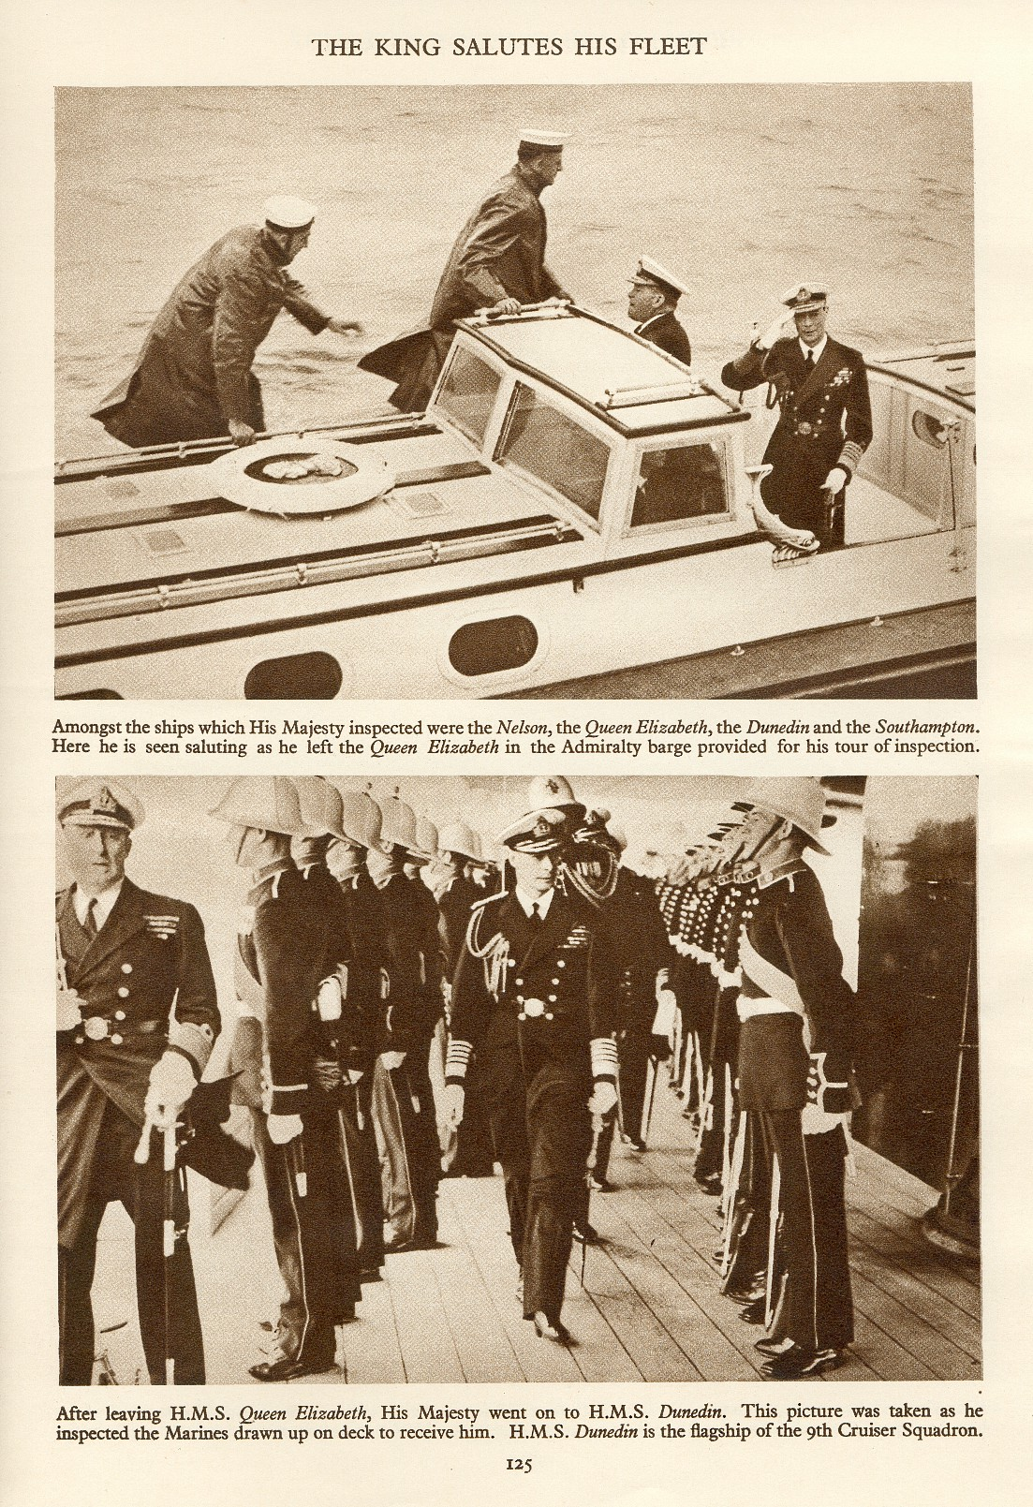
Notes:
George VI 1937

Slide 16
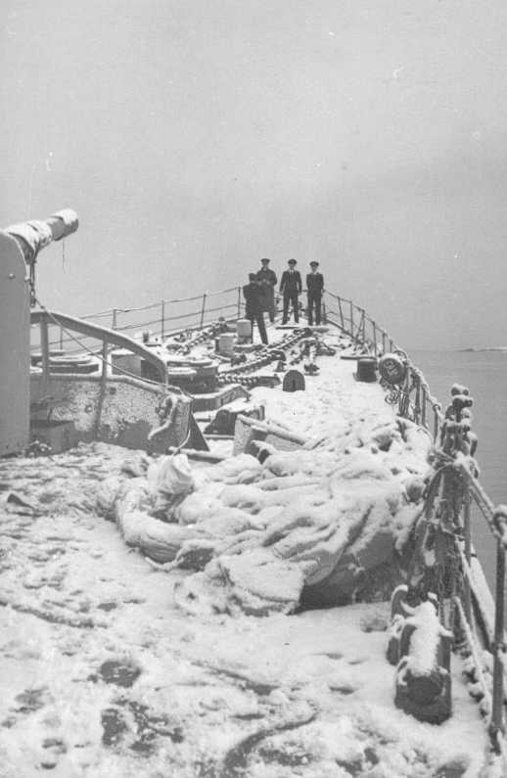
Notes:
Northern Patrol – Scapa Flow 25 or 31 Dec 1939

Slide 17
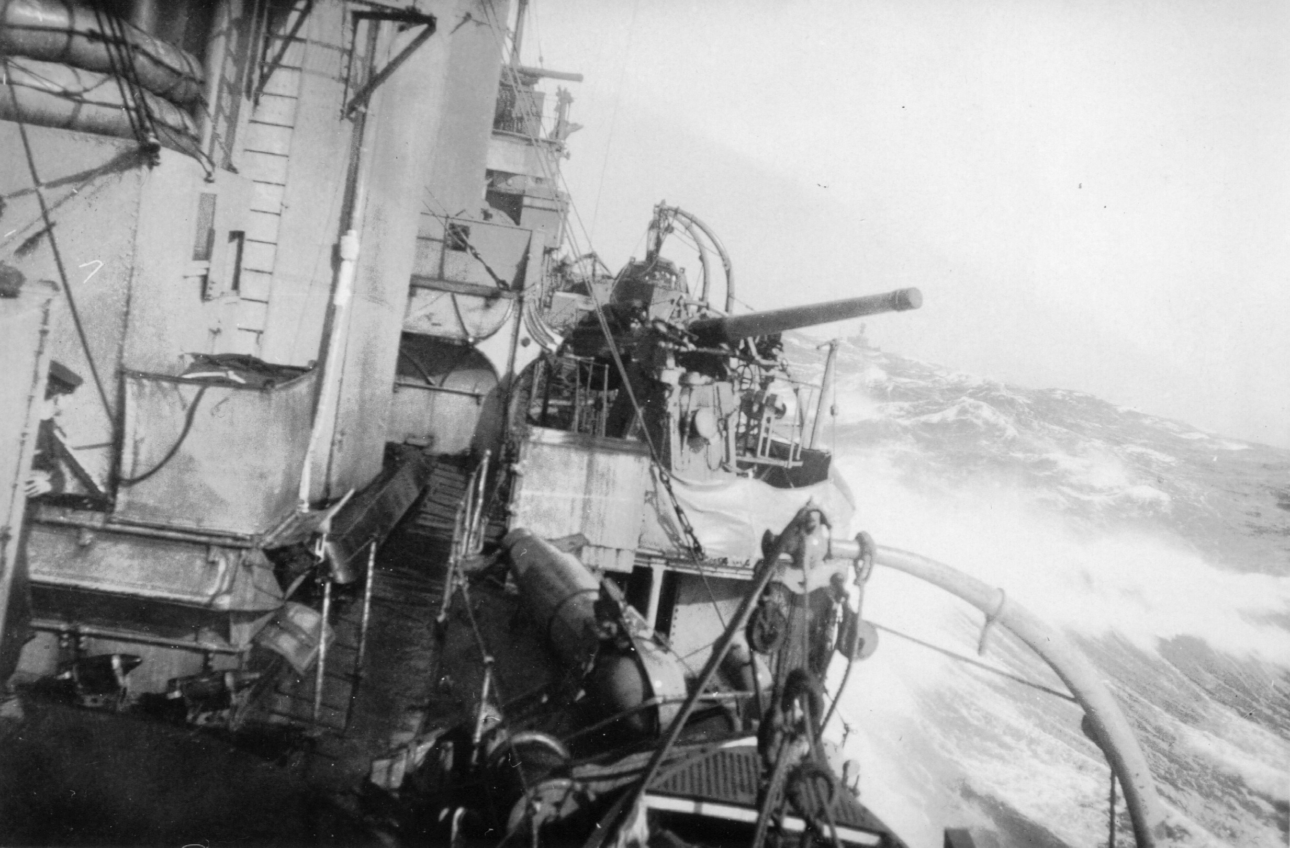
Notes:
Northern Patrol

Slide 18
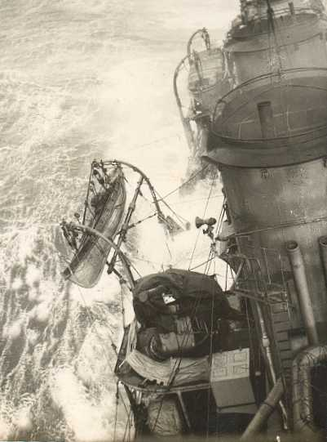
Notes:
Atlantic Crossing

Slide 19
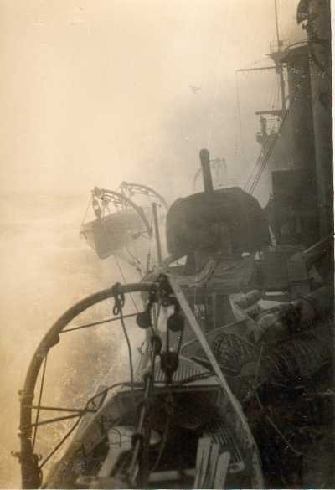

Slide 20
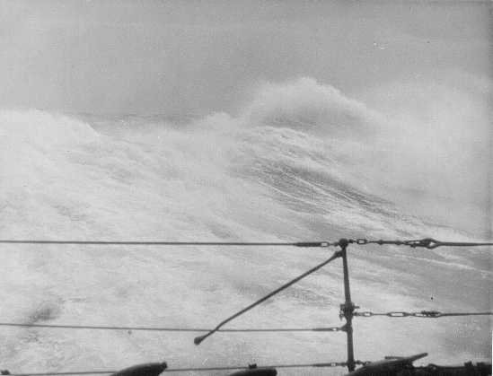

Slide 21
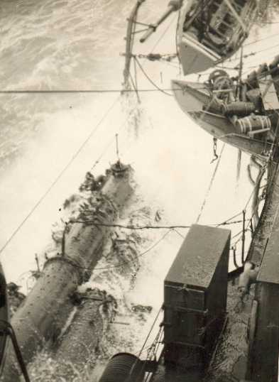

Slide 22
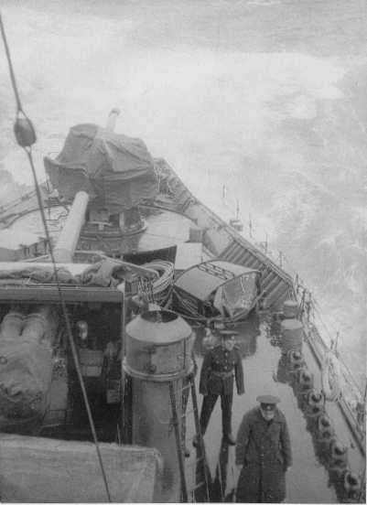

Slide 23
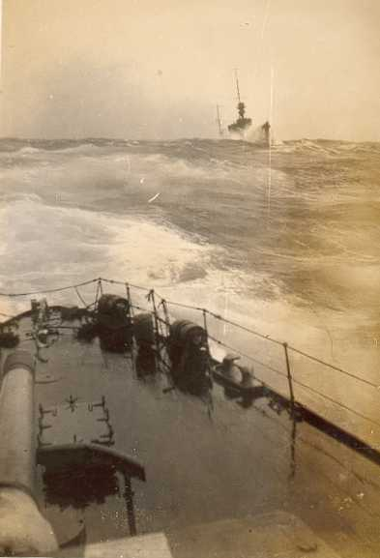

Slide 24
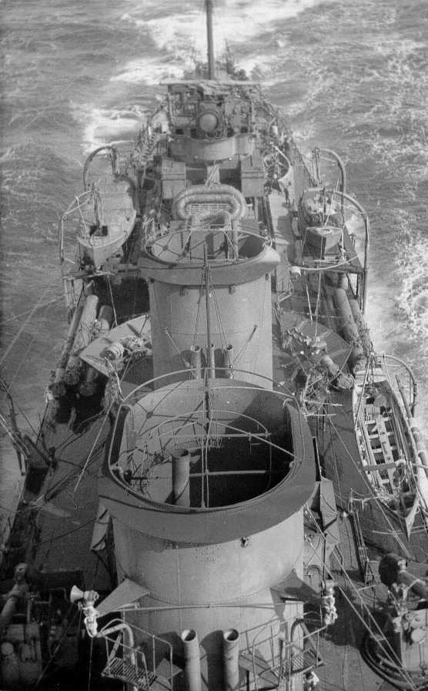
Notes:
Last Atlantic Crossing slide

Slide 25
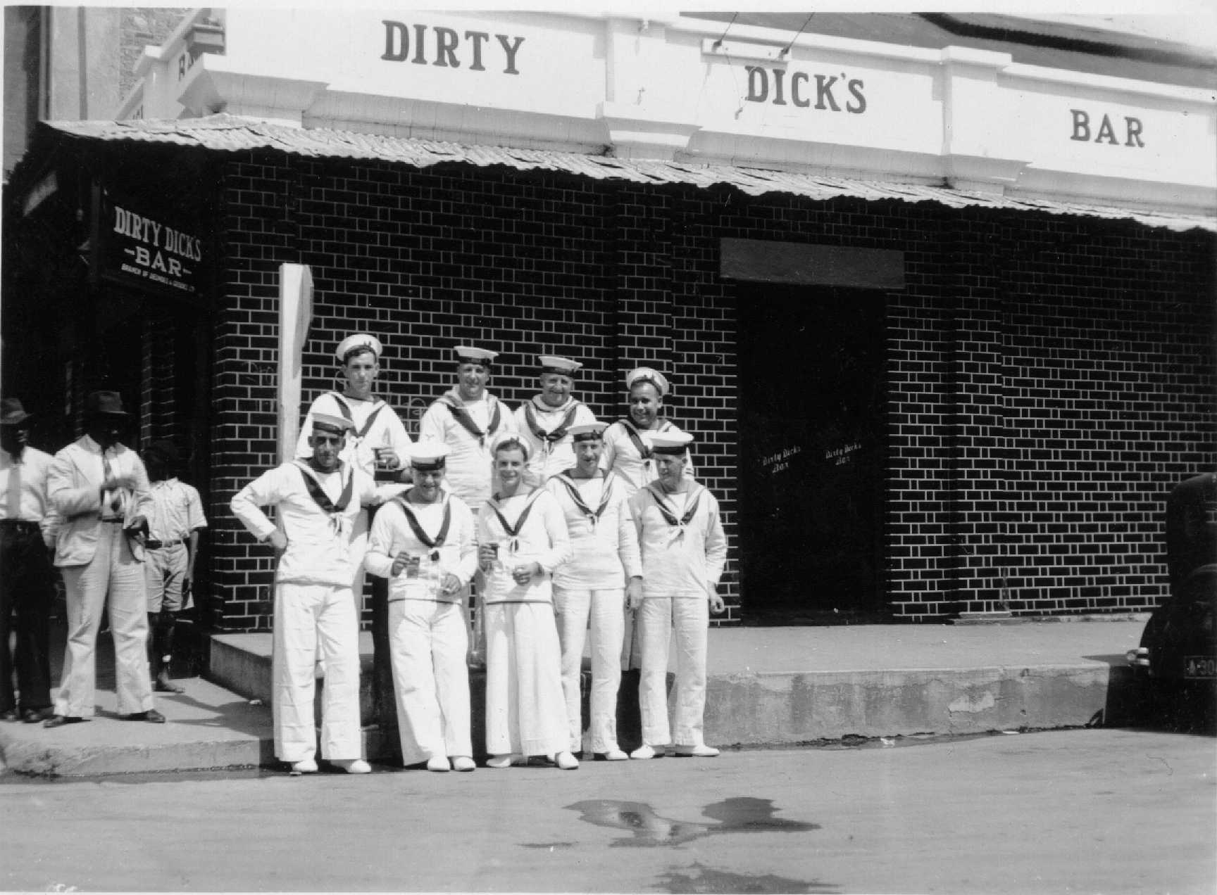
Notes:
Dirty Dick’s Bar, Jamaica

Slide 26
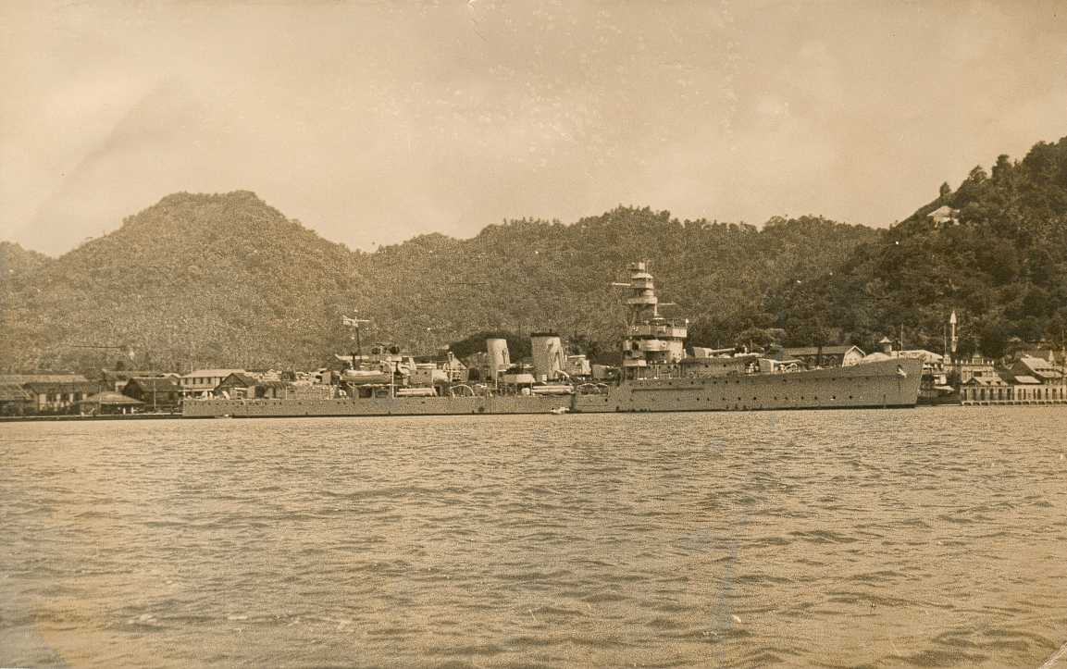
Notes:
Bermuda

Slide 27
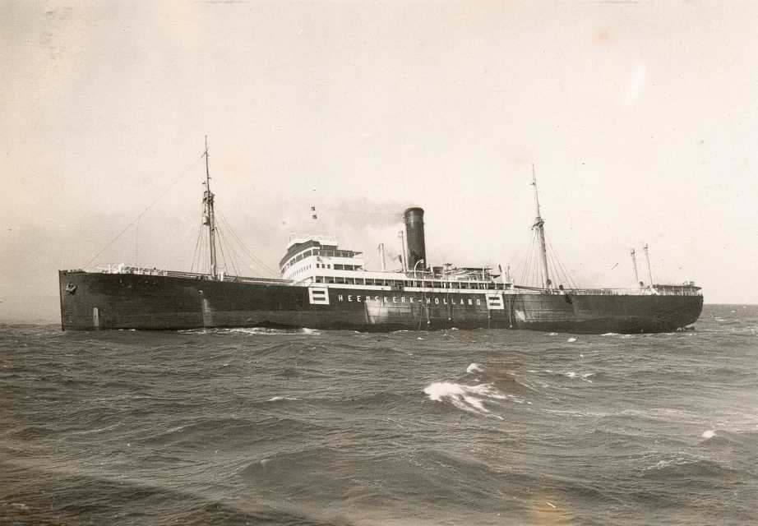
Notes:
Heidelberg

Slide 28
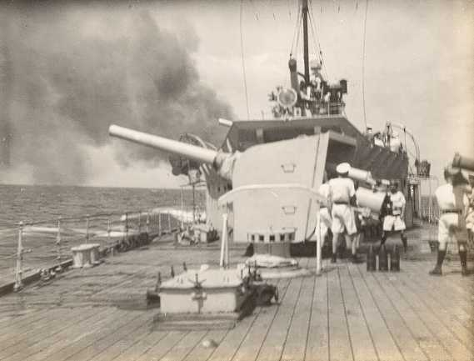
Notes:
Firing at Heidelberg

Slide 29
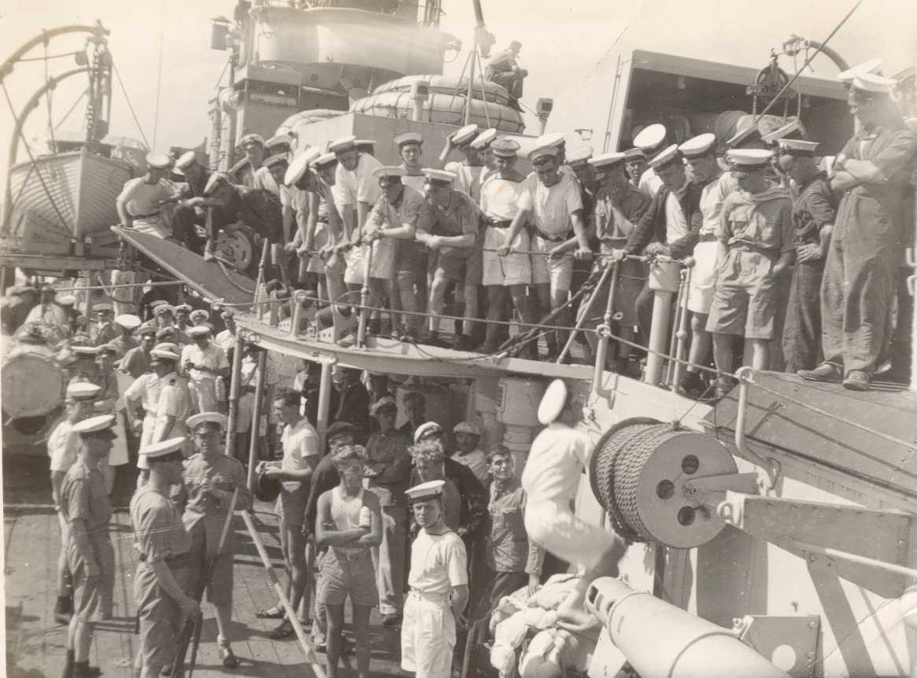
Notes:
Heidelberg prisoners

Slide 30
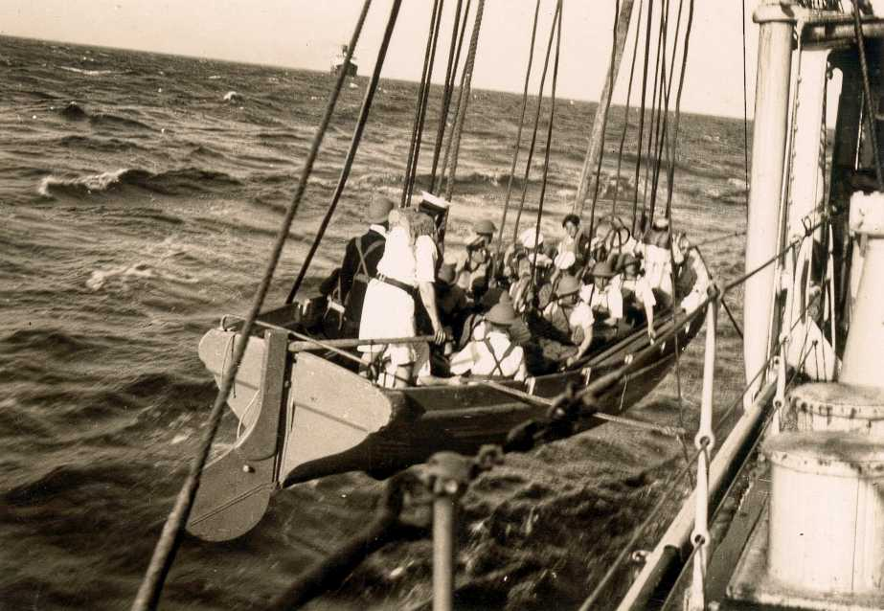
Notes:
Boarding Party for Heidelberg

Slide 31
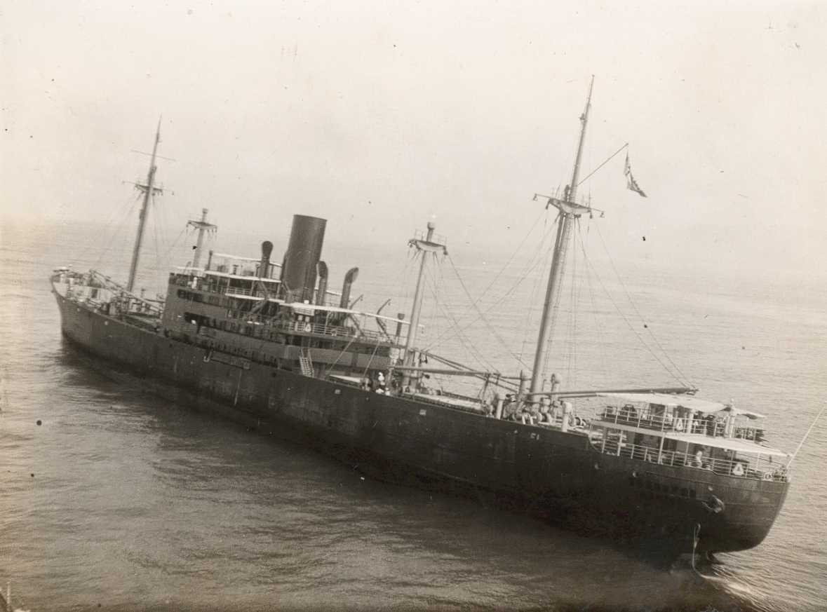
Notes:
Hannover

Slide 32
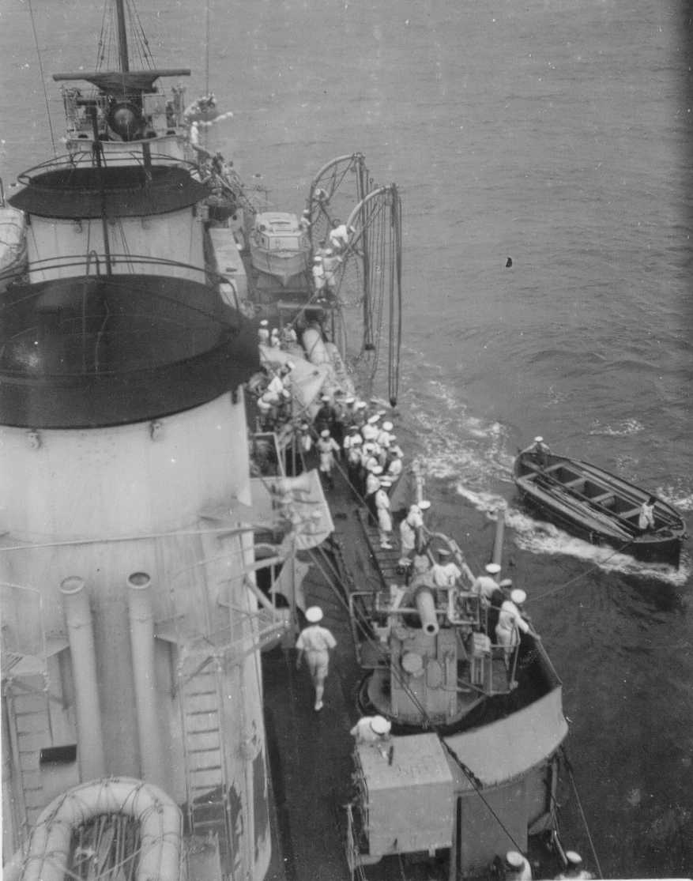
Notes:
Hannover prisoners arriving – note my father’s Carley Raft in the foreground

Slide 33
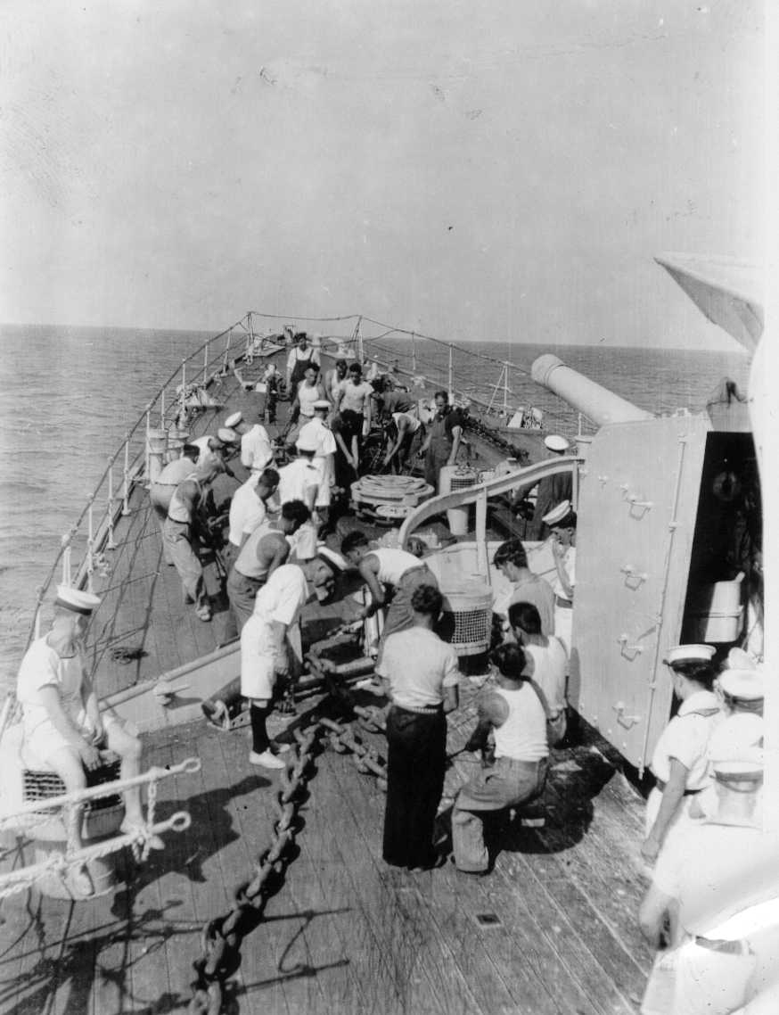
Notes:
German prisoners working

Slide 34
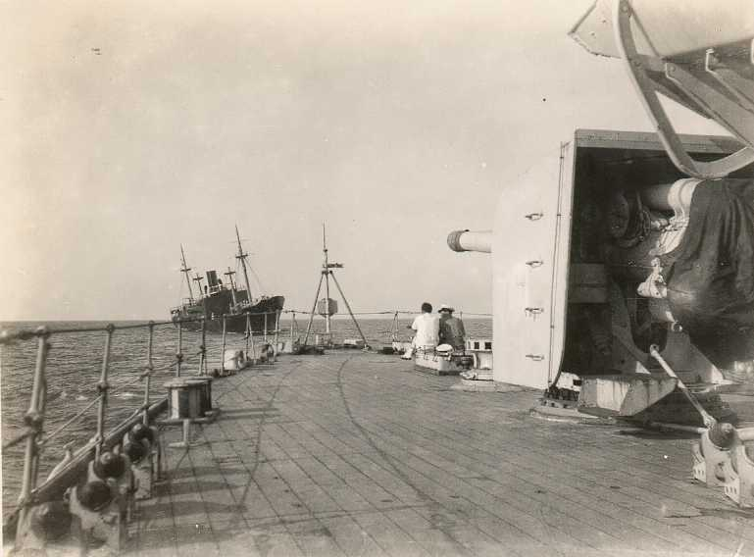
Notes:
View of Hannover from quarterdeck of Dunedin

Slide 35
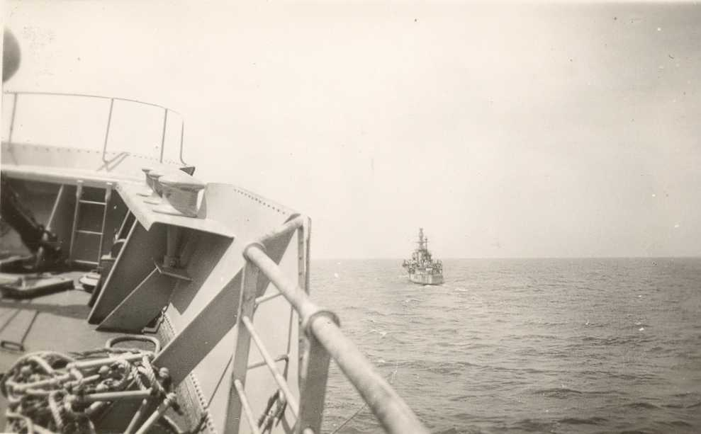
Notes:
View of Dunedin from Hannover

Slide 36
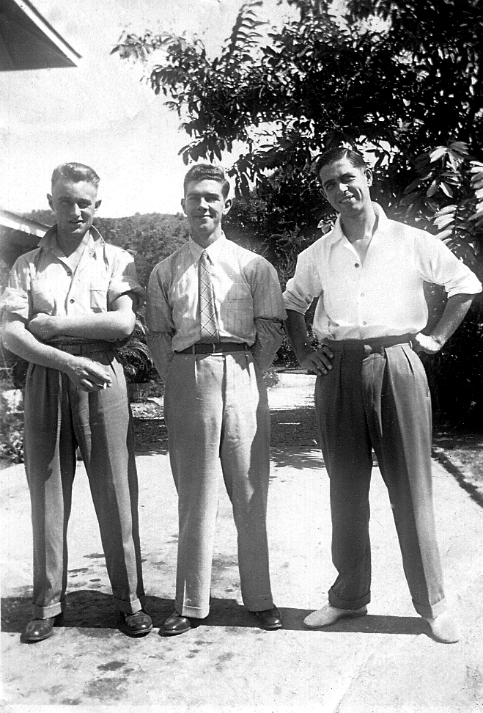
Notes:
Somewhere in the Caribbean, Jim Davis on right

Slide 37
Notes:
Dunedin back to the UK for convoy escort duty then back to Britain, when this man joined the ship, in March 1941

Slide 38
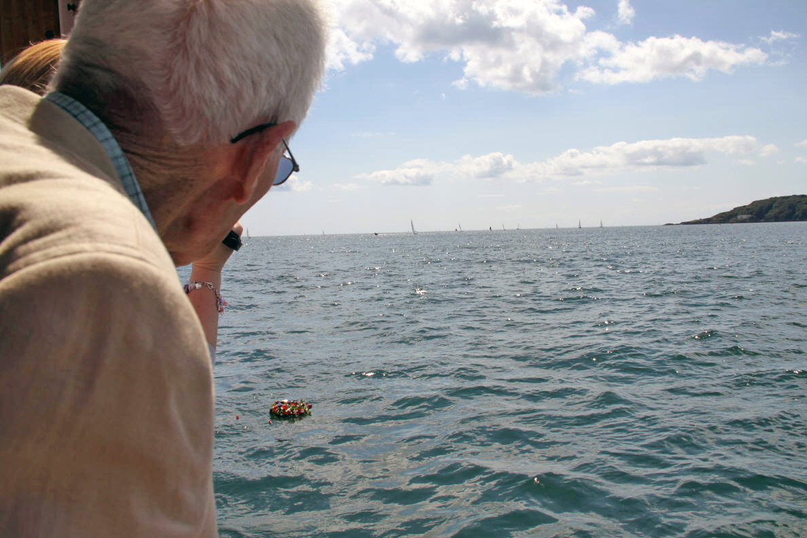
Notes:
Seventy years after Dunedin left Plymouth

Slide 39
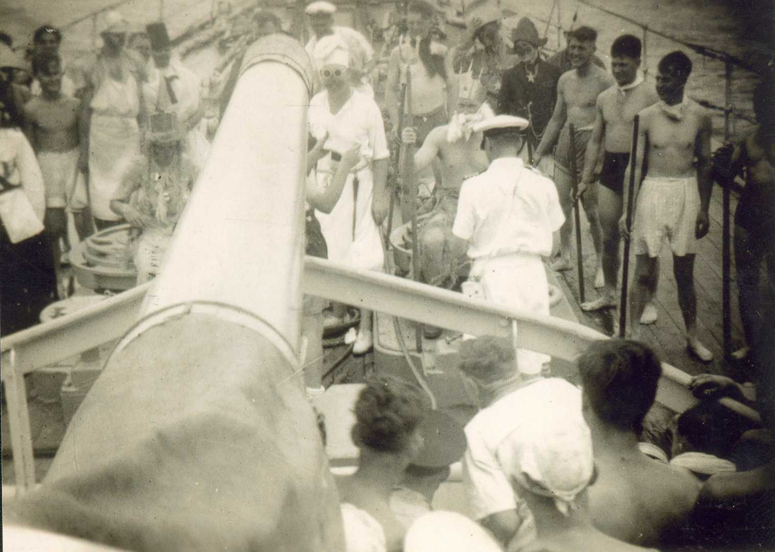
Notes:
Crossing the Line Ceremony, 28th April 1941

Slide 40
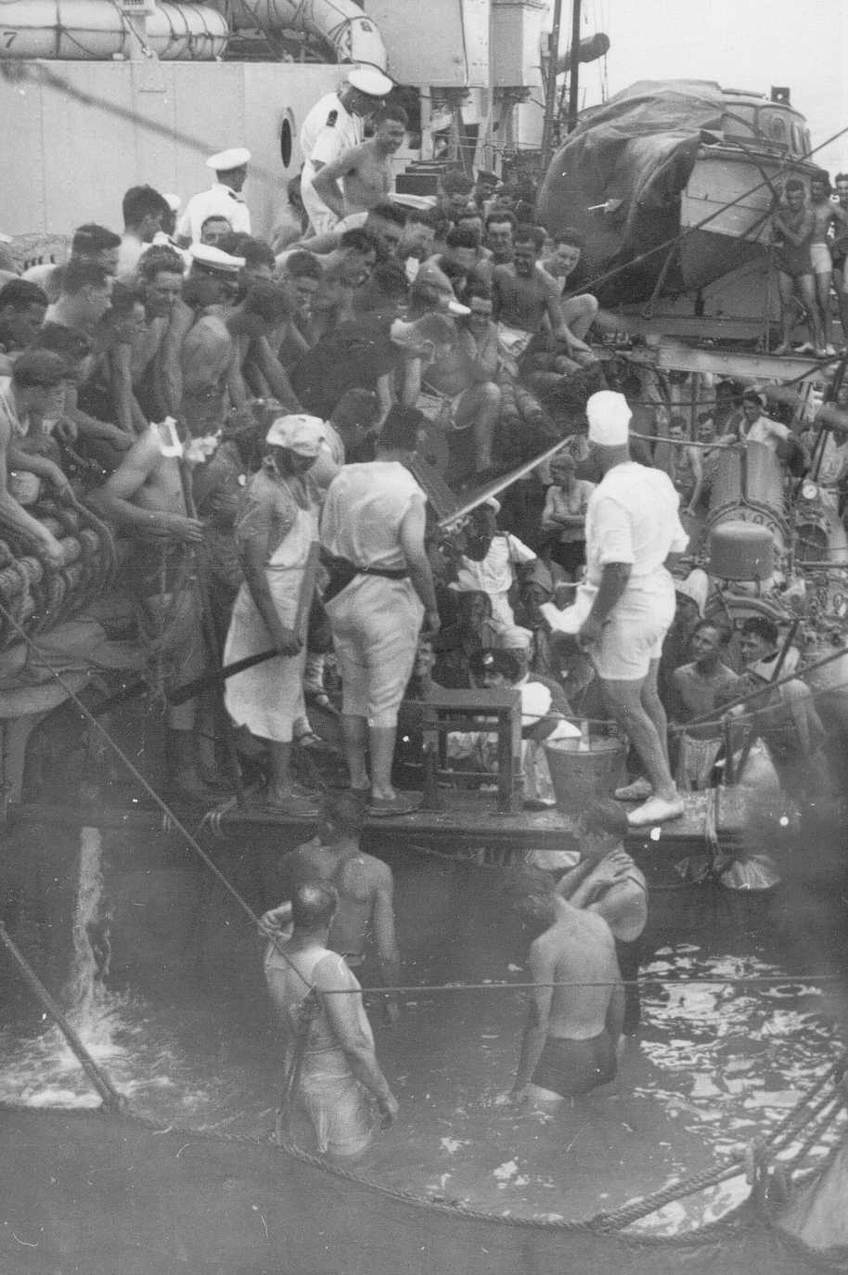

Slide 41
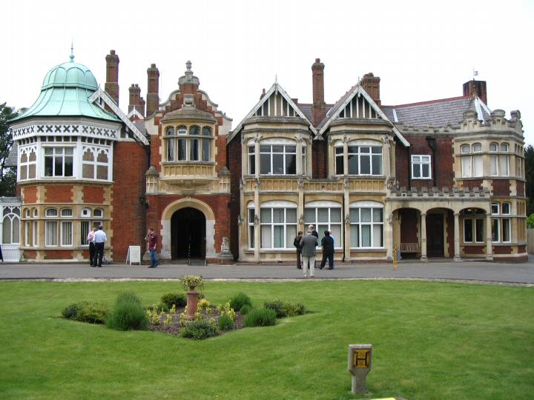

Slide 42
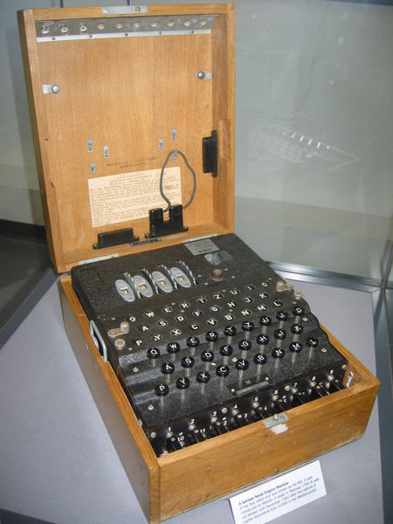

Slide 43
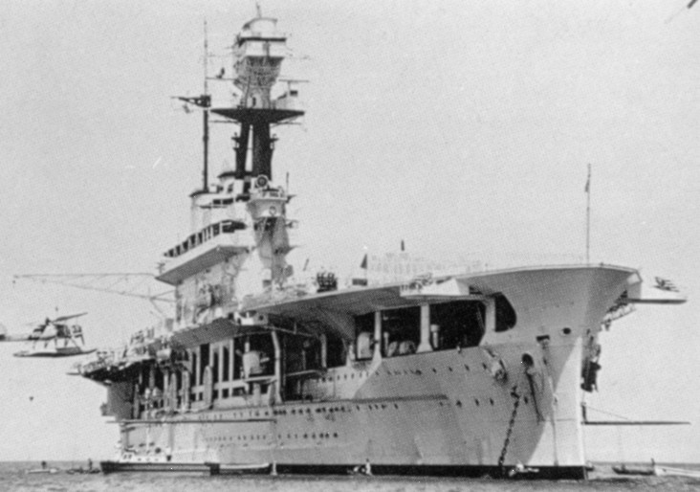
Notes:
HMS Eagle

Slide 44
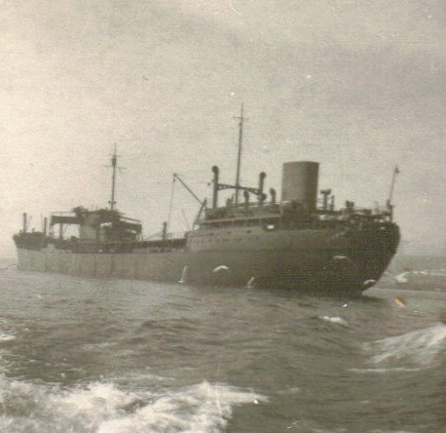
Notes:
Lothringen

Slide 45
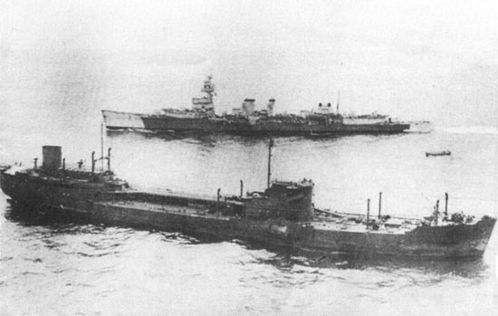
Notes:
Capture of Lothringen, 15th June 1941

Slide 46
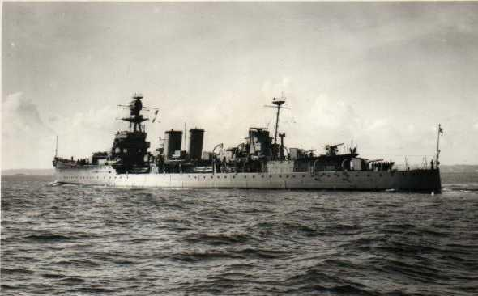
Notes:
Fast forward to November 1941 – possibly the last ever photo taken of Dunedin as she left Freetown for the final time

Slide 47
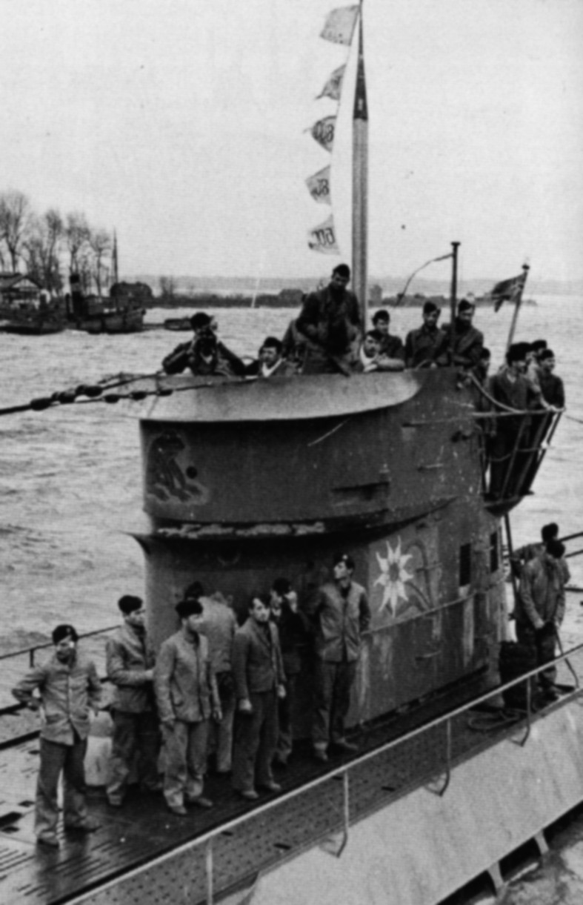

Slide 48
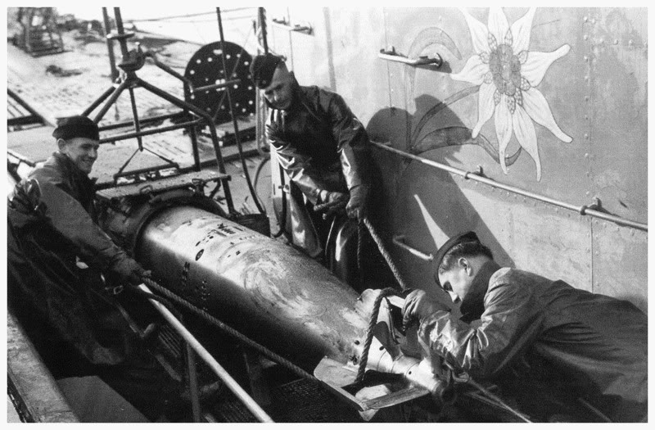
Notes:
U-124 Torpedo. Hmm.

Slide 49
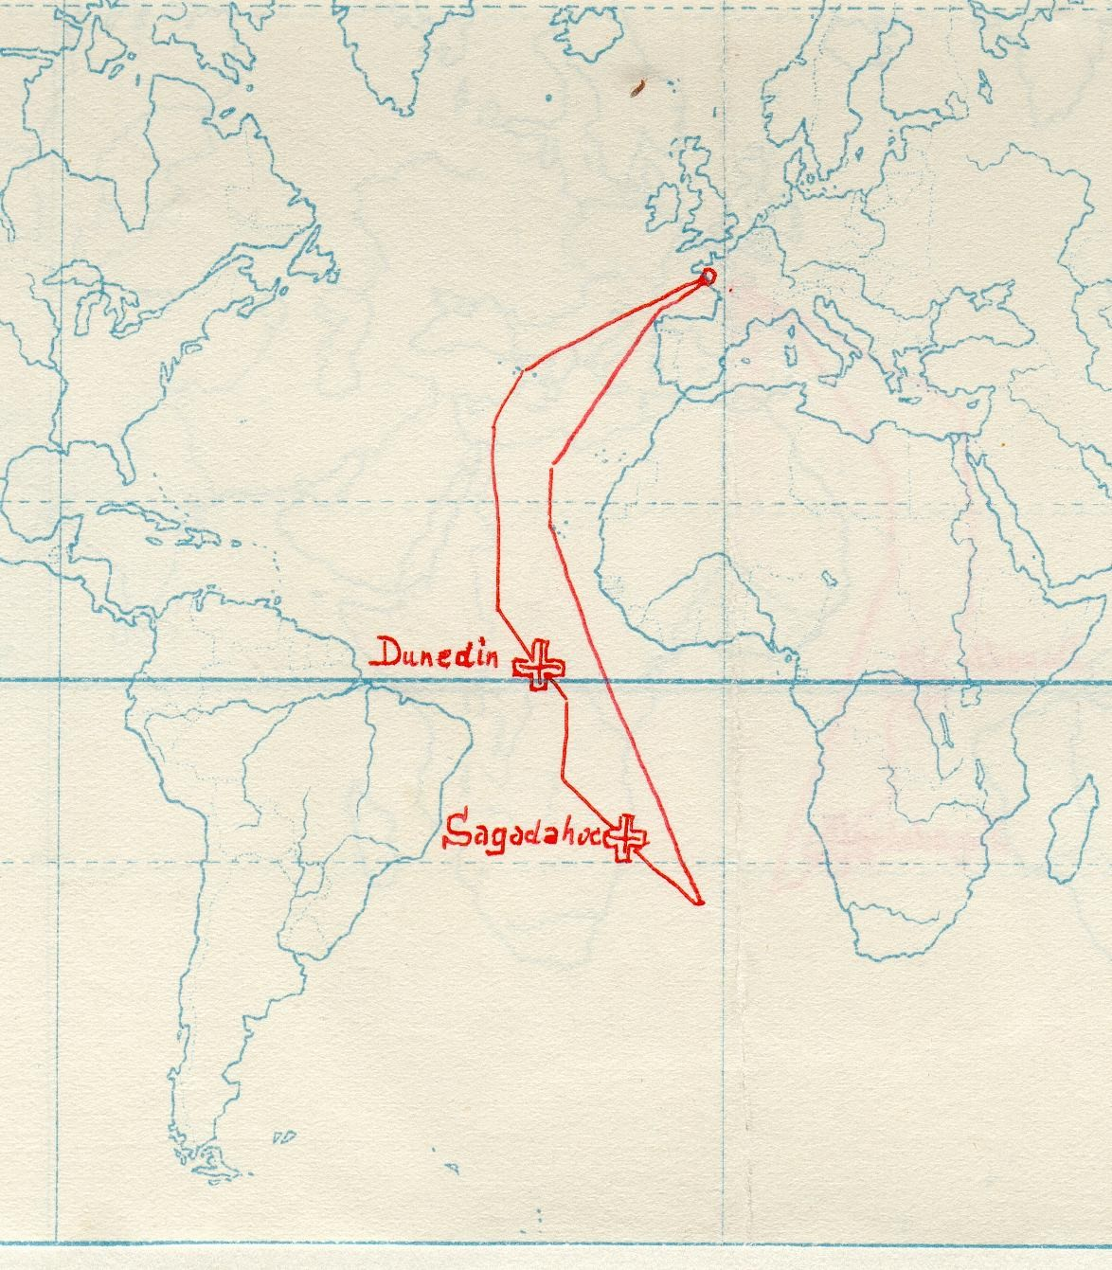
Notes:
Describe what happened – the chase, the attack, the fourth torpedo

Slide 50
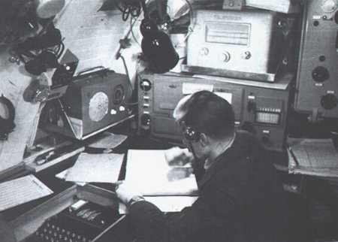

Slide 51
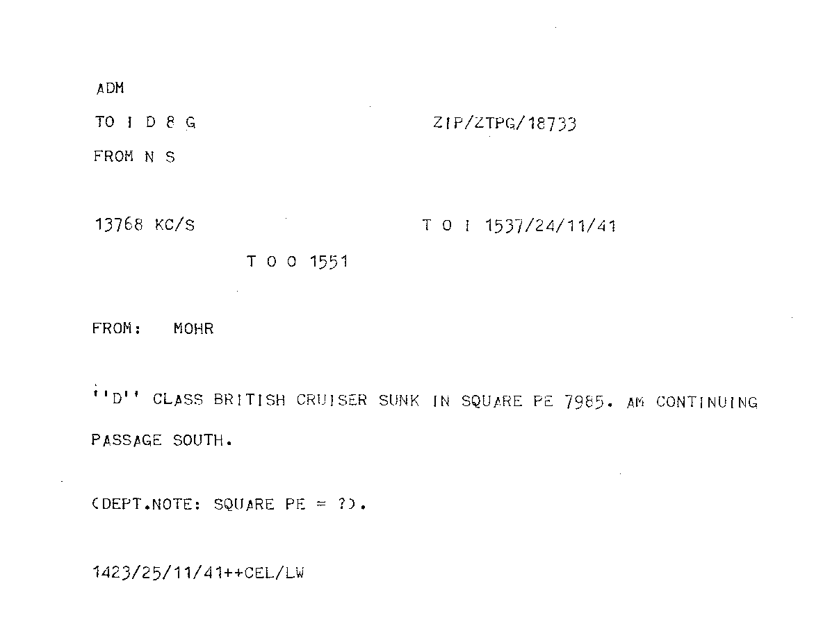

Slide 52
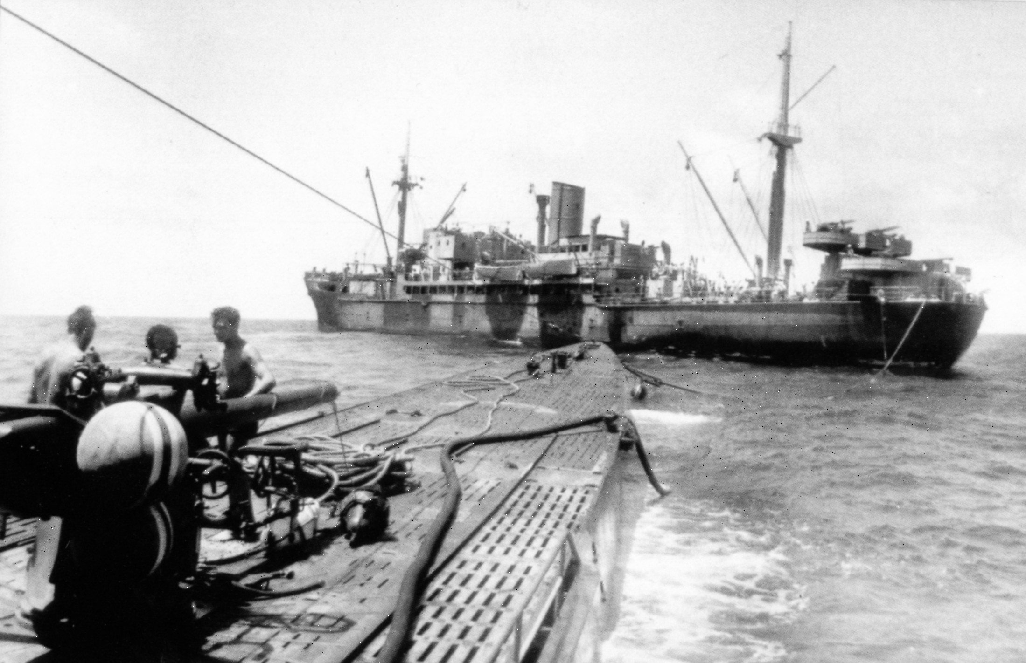
Notes:
U-124 and Python, possibly 27 or 28 November 1941

Slide 53
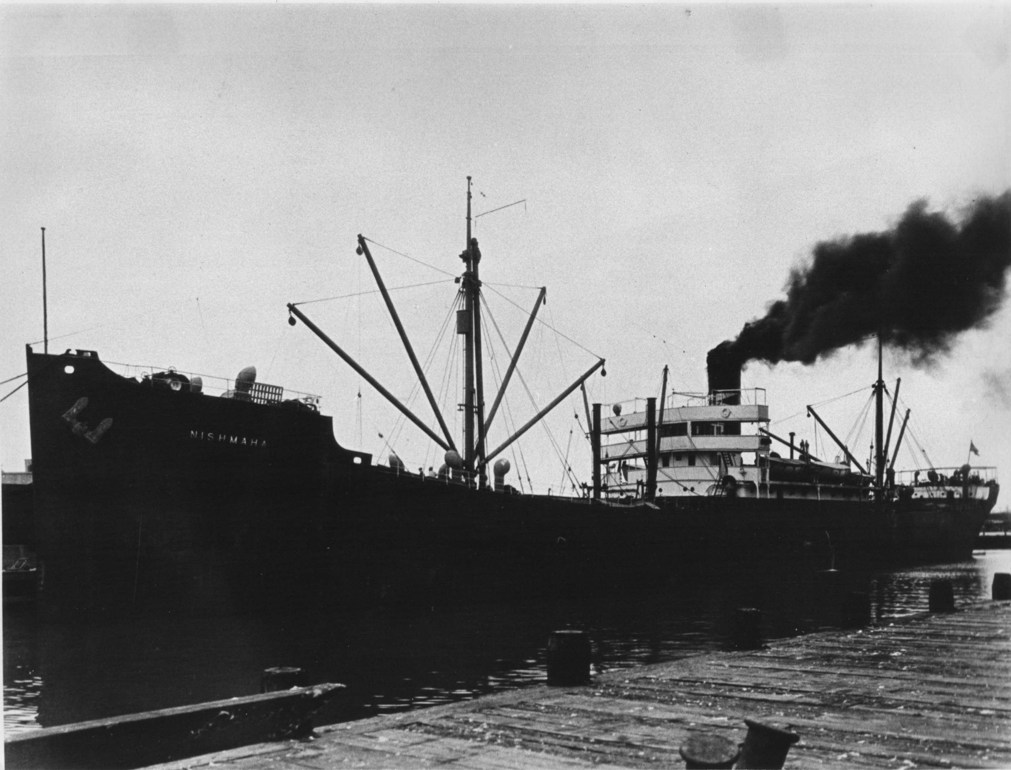

Slide 54
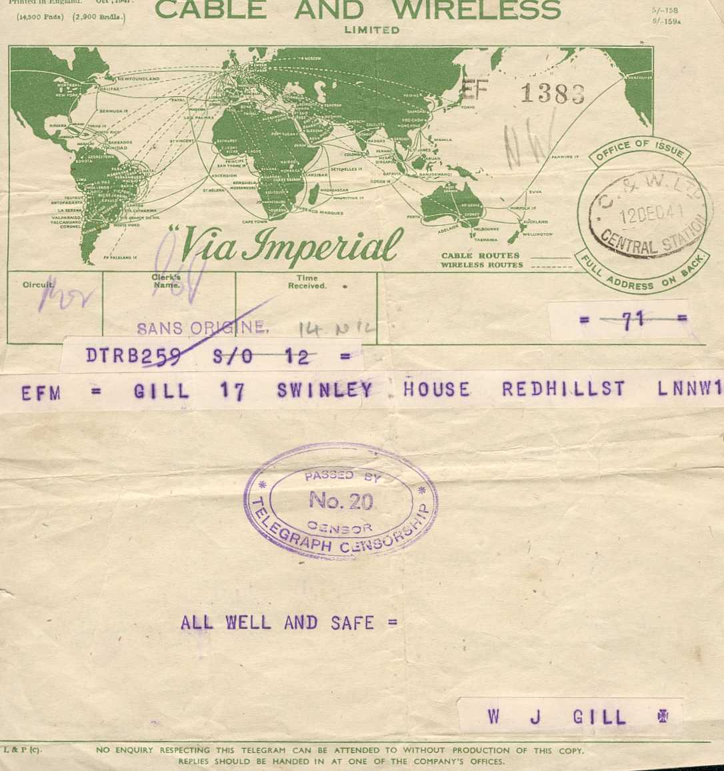

Slide 55
